Slide 1
The Path to Self -Transformation
A Journey in Subconscious Reprogramming
Storyboard document
Notes:
This assessment has three levels of storyboarding.

Slide 2
Level 1 Storyboard
Notes:
The storyboard begins from the next slide and is a level 1 storyboard of the same concept. Level 1 Storyboard includes simple interactions like click next and voice-over, and static images to support the concept.

Slide 3


Mental Wellness
Subconscious Reprogramming
Start
Notes:
Screen No.: 1
Screen Type: static
Narration: Welcome to the course on mental wellness. And today, we will learn about subconscious reprogramming.
Art Direction Notes: Na

Slide 4
Subconscious Reprogramming
In this course, you’ll :
Understand Subconscious Reprogramming
Identify the negative thought patterns
Techniques to reprogram the subconscious mind
<
>
Notes:
Screen No.: 2
Screen Type: static
Narration:
In this course, you’ll :
Understand Subconscious Reprogramming
Identify the negative thought patterns
Techniques to reprogram the subconscious mind
Art Direction Notes: Synch the OST with VO.

Slide 5

Subconscious Reprogramming
Click > icon to continue
Subconscious reprogramming involves techniques and practices aimed at changing the beliefs, thought
patterns and habits stored in your subconscious mind.
<
>
Notes:
Screen No.: 3
Screen Type: static
Narration: Subconscious reprogramming involves techniques and practices aimed at changing the beliefs, thought
patterns and habits stored in your subconscious mind.
Click > icon to continue
Art Direction Notes: Synch the OST with VO.

Slide 6

Techniques for Subconscious Reprogramming
Click > icon to continue
While there are various approaches to this process, here are some general steps and methods you can consider for subconscious reprogramming.
Self Awareness
Set Clear Intentions
Positive Affirmations
Visualization
Meditation and Mindfulness
Hypnosis
Subliminal Messages
Emotional Freedom Technique (EFT)
Neuro-Linguistic Programming
Repetition
Seek Professional Help
Be Patient and Persistent
<
>
Notes:
Screen No.: 4
Screen Type: static
Narration: While there are various approaches to this process, here are some general steps and methods you can consider for subconscious reprogramming.
Self Awareness
Set Clear Intentions
Positive Affirmations
Visualization
Meditation and Mindfulness
Hypnosis
Subliminal Messages
Emotional Freedom Technique (EFT)
Neuro-Linguistic Programming
Repetition
Seek Professional Help
Be Patient and Persistent
Click > icon to continue
Art Direction Notes: Synch the OST with VO.

Slide 7

Self-Awareness
Click > icon to continue
The first step is becoming aware of the negative or limiting beliefs and thought
patterns you want to change. This requires self-reflection and introspection. You can use journaling to help identify these beliefs and thought patterns.
<
>
Notes:
Screen No.: 5
Screen Type: static
Narration: The first step is becoming aware of the negative or limiting beliefs and thought patterns you want to change. This requires self-reflection and introspection. You can use journaling to help identify these beliefs and thought patterns.
Click > icon to continue
Art Direction Notes: Synch the OST with VO.

Slide 8

Set Clear Intentions
Click > icon to continue
Clearly define what you want to achieve through subconscious reprogramming. Your goals should be specific, measurable, achievable, relevant, and time-bound (SMART goals).
<
>
Notes:
Screen No.: 6
Screen Type: static
Narration: Clearly define what you want to achieve through subconscious reprogramming. Your goals should be specific, measurable, achievable, relevant, and time-bound (SMART goals).
Click > icon to continue
Art Direction Notes: Synch the OST with VO.

Slide 9
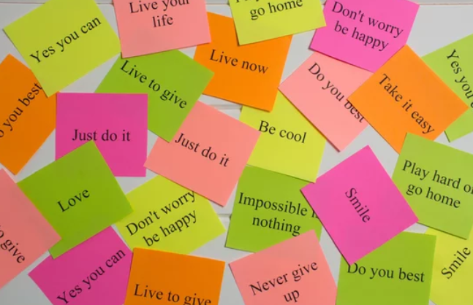
Positive Affirmations
Click > icon to continue
Create positive affirmations that counteract your negative beliefs.
Affirmations are positive statements that you repeat to yourself regularly. They should be in the present tense and reflect the desired state of your subconscious mind. For example, I am
confident and capable.
<
>
Notes:
Screen No.: 7
Screen Type: static
Narration: Create positive affirmations that counteract your negative beliefs.
Affirmations are positive statements that you repeat to yourself regularly. They should be in the present tense and reflect the desired state of your subconscious mind. For example, I am confident and capable.
Click > icon to continue
Art Direction Notes: Synch the OST with VO.

Slide 10
Summary
In this course, you learn about:
Subconscious Reprogramming
Negative thought patterns
Techniques to reprogram the subconscious mind
<
>
Notes:
Screen No.: 8
Screen Type: static
Narration:
In this course, you learn about:
Subconscious Reprogramming
Negative thought patterns
Techniques to reprogram the subconscious mind
Art Direction Notes: Synch the OST with VO.

Slide 11
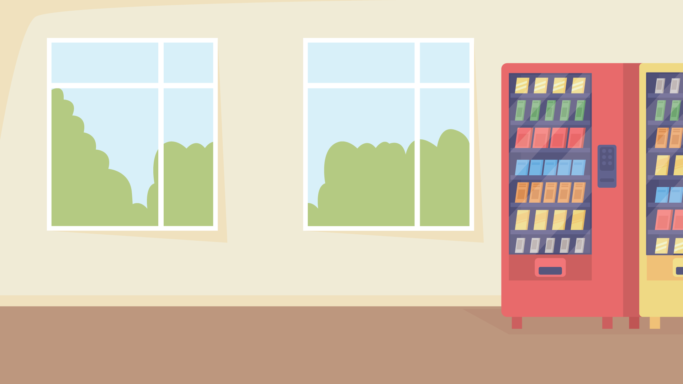
KNOWLEDGE
CHECK
Notes:
Screen Type: Transition Screen
Narration: So that’s a lot to keep track of. Let’s see how much you remember.
Art Direction Notes: Screen will transition to the next topic after the audio.

Slide 12
Q
Q1: Which is the first step in subconscious reprogramming?
Select the suitable option and Submit when you are finished.
Hypnosis
Visualization
Self Awareness
Positive Affirmation
Submit
Notes:
Screen No.: 9
Screen Type: KC 1 – MCQ
Narration: Which is the first step in subconscious reprogramming?
Select the suitable option and Submit when you are finished.
Art Direction Notes:
Correct answer: Self-awareness.
Correct Feedback: That’s right! Self-awareness is the first step towards subconscious reprogramming.
Incorrect Feedback: Not quite. Try again.

Slide 13

Q
Q1: Which is the first step in subconscious reprogramming?
Select the suitable option and Submit when you are finished.
Hypnosis
Visualization
Self Awareness
That’s right! Self-awareness is the first step towards subconscious reprogramming.
Positive Affirmation
Submit
Notes:
Screen No.: 9
Screen Type: KC 1 – MCQ
Narration: Which is the first step in subconscious reprogramming?
Select the suitable option and Submit when you are finished.
Art Direction Notes:
Correct answer: Self-awareness.
Correct Feedback: That’s right! Self-awareness is the first step towards subconscious reprogramming.
Incorrect Feedback: Not quite. Try again.

Slide 14
Q
Q1: Which is the first step in subconscious reprogramming?
Select the suitable option and Submit when you are finished.
Hypnosis
Visualization
Self Awareness
Not quite. Try Again!
Positive Affirmation
Try Again
Submit
Notes:
Screen No.: 9
Screen Type: KC 1 – MCQ
Narration: Which is the first step in subconscious reprogramming?
Select the suitable option and Submit when you are finished.
Art Direction Notes:
Correct answer: Self-awareness.
Correct Feedback: That’s right! Self-awareness is the first step towards subconscious reprogramming.
Incorrect Feedback: Not quite. Try again.

Slide 15
Q
Q2: What is the purpose of setting SMART goals in subconscious reprogramming?
Select the suitable option and Submit when you are finished.
To maintain journal
To increase self-awareness
To establish clear intentions
To use positive affirmations
Submit
Notes:
Screen No.: 10
Screen Type: KC 1 – MCQ
Narration: What is the purpose of setting SMART goals in subconscious reprogramming?
Select the suitable option and Submit when you are finished.
Art Direction Notes:
Correct answer: To establish clear intentions.
Correct Feedback: That’s right! The purpose of SMART is to set the clear intentions.
Incorrect Feedback: Not quite. Try again.

Slide 16
Q
Q2: What is the purpose of setting SMART goals in subconscious reprogramming?
Select the suitable option and Submit when you are finished.
To maintain journal
To increase self-awareness
To establish clear intentions
That’s right! The purpose of SMART is to set clear intentions.
To use positive affirmations
Submit
Notes:
Screen No.: 10
Screen Type: KC 1 – MCQ
Narration: What is the purpose of setting SMART goals in subconscious reprogramming?
Select the suitable option and Submit when you are finished.
Art Direction Notes:
Correct answer: To establish clear intentions.
Correct Feedback: That’s right! The purpose of SMART is to set the clear intentions.
Incorrect Feedback: Not quite. Try again.

Slide 17
Q
Q2: What is the purpose of setting SMART goals in subconscious reprogramming?
Select the suitable option and Submit when you are finished.
To maintain journal
To increase self-awareness
To establish clear intentions
Not quite. Try Again!
To use positive affirmations
Try Again
Submit
Notes:
Screen No.: 10
Screen Type: KC 1 – MCQ
Narration: What is the purpose of setting SMART goals in subconscious reprogramming?
Select the suitable option and Submit when you are finished.
Art Direction Notes:
Correct answer: To establish clear intentions.
Correct Feedback: That’s right! The purpose of SMART is to set the clear intentions.
Incorrect Feedback: Not quite. Try again.

Slide 18
Level 2 Storyboard
Notes:
The storyboard begins from the next slide and is a level 2 storyboard of the same concept. Level 2 Storyboard includes more interactivities than Level 1. For eg, click to reveal hotspot interactivities with voice-overs and static images.

Slide 19
Mental Wellness Series
Module on
Subconscious Reprogramming
Enter your name
Start
Notes:
Screen No.: 1
Screen Type: static
Narration: Welcome to the course on mental wellness. And today, we will learn about subconscious reprogramming.
Art Direction Notes: The learner will not be able to navigate until learner enters their name in the text box.

Slide 20
Subconscious Reprogramming
In this course, you’ll :
Understand Subconscious Reprogramming
Identify the negative thought patterns
Techniques to reprogram the subconscious mind
<
>
Notes:
Screen No.: 2
Screen Type: static
Narration:
In this course, you’ll :
Understand Subconscious Reprogramming
Identify the negative thought patterns
Techniques to reprogram the subconscious mind
Art Direction Notes: Synch the OST with VO.

Slide 21
Subconscious Reprogramming
Click > icon to continue
Subconscious reprogramming involves techniques and practices aimed at changing the beliefs, thought
patterns and habits stored in your subconscious mind.
<
>
Notes:
Screen No.: 3
Screen Type: static
Narration: Subconscious reprogramming involves techniques and practices aimed at changing the beliefs, thought
patterns and habits stored in your subconscious mind.
Click > icon to continue
Art Direction Notes: Synch the OST with VO.

Slide 22
Techniques for Subconscious Reprogramming
Click > icon to continue
While there are various approaches to this process, here are some general steps and methods you can consider for subconscious reprogramming.
Self Awareness
Set Clear Intentions
Positive Affirmations
Visualization
Meditation and Mindfulness
Hypnosis
Subliminal Messages
Emotional Freedom Technique (EFT)
Neuro-Linguistic Programming
Repetition
Seek Professional Help
Be Patient and Persistent
<
>
Notes:
Screen No.: 4
Screen Type: static
Narration: While there are various approaches to this process, here are some general steps and methods you can consider for subconscious reprogramming.
Self Awareness
Set Clear Intentions
Positive Affirmations
Visualization
Meditation and Mindfulness
Hypnosis
Subliminal Messages
Emotional Freedom Technique (EFT)
Neuro-Linguistic Programming
Repetition
Seek Professional Help
Be Patient and Persistent
Click > icon to continue
Art Direction Notes: Synch the OST with VO.

Slide 23
Techniques for Subconscious Reprogramming
Click on the card to flip
1.
Self Awareness
2.
Set Clear Intentions
3.
Positive Affirmations
<
>
Notes:
Screen No.: 5
Screen Type: Flash cards/ Click to reveal interactivity
Narration: While there are various approaches to this process, here are some general steps and methods you can consider for subconscious reprogramming.
Self Awareness
Set Clear Intentions
Positive Affirmations
Click on the card to flip
Art Direction Notes: Disable the next button.

Slide 24
Techniques for Subconscious Reprogramming
Click on the card to flip
2.
Set Clear Intentions
3.
Positive Affirmations
Be aware of negative or limiting beliefs and thoughts
Requires self-reflection and introspection
Start writing journal to identify these beliefs and thought patterns.
<
>
Notes:
Continued screen
Screen No.: 5
Screen Type: Flash cards/ Click to reveal interactivity
Narration: NA
Art Direction Notes: Disable the next button.

Slide 25
Techniques for Subconscious Reprogramming
Click on the card to flip
1.
Self Awareness
3.
Positive Affirmations
Define what you want to achieve
Your goals should be specific, measurable, achievable, relevant, and time-bound.
<
>
Notes:
Continued screen
Screen No.: 5
Screen Type: Flash cards/ Click to reveal interactivity
Narration: NA
Art Direction Notes: Disable the next button.

Slide 26
Techniques for Subconscious Reprogramming
Click on the card to flip
1.
Self Awareness
2.
Set Clear Intentions
Create positive affirmations counteracting your negative beliefs
It should be in the
present tense
It should reflect desired state of your subconscious mind.
<
>
Notes:
Continued screen
Screen No.: 5
Screen Type: Flash cards/ Click to reveal interactivity
Narration: NA
Art Direction Notes: Disable the next button.

Slide 27
Summary
In this course, you learn about:
Subconscious Reprogramming
Negative thought patterns
Techniques to reprogram the subconscious mind
<
>
Notes:
Screen No.: 6
Screen Type: static
Narration:
In this course, you learn about:
Subconscious Reprogramming
Negative thought patterns
Techniques to reprogram the subconscious mind
Art Direction Notes: Synch the OST with VO.

Slide 28
KNOWLEDGE
CHECK
Notes:
Screen Type: Transition Screen
Narration: So that’s a lot to keep track of. Let’s see how much you remember.
Art Direction Notes: Screen will transition to the next topic after the audio.

Slide 29
Q
Q1: Drag the elements from the left column to match the correct corresponding actions on the right column.
Drag and drop the appropriate elements of the self-awareness and positive affirmations process. Click Submit when you are finished.
Self-Awareness
Positive Affirmations
Identifying limiting beliefs
Creating positive statements
Keeping a journal
Ensuring present tense
Repeating regularly
Submit
Reflecting on negative thought patterns
Notes:
Screen No.: 7
Screen Type: KC 1 – Drag and drop
Narration: Drag the elements from the left column to match the correct corresponding actions on the right column.
Drag and drop the appropriate elements of the self-awareness and positive affirmations process. Click Submit when you are finished.
Art Direction Notes:
Correct Matching:
[Self-Awareness]
Identifying limiting beliefs
Reflecting on negative thought patterns
Keeping a journal
[Positive Affirmations]
1. Creating positive statements
2. Repeating regularly
3. Ensuring present tense
Correct Feedback: That’s right!
Incorrect Feedback: Not quite. Try again.

Slide 30
Q
Q1: Drag the elements from the left column to match the correct corresponding actions on the right column.
Drag and drop the appropriate elements of the self-awareness and positive affirmations process. Click Submit when you are finished.
Self-Awareness
Positive Affirmations
Identifying limiting beliefs
Creating positive statements
Keeping a journal
Repeating regularly
That’s right!
Reflecting on negative thought patterns
Ensuring present tense
Submit
Notes:
Screen No.: 7
Screen Type: KC 1 – Drag and drop
Narration: Drag the elements from the left column to match the correct corresponding actions on the right column.
Drag and drop the appropriate elements of the self-awareness and positive affirmations process. Click Submit when you are finished.
Art Direction Notes:
Correct Matching:
[Self-Awareness]
Identifying limiting beliefs
Reflecting on negative thought patterns
Keeping a journal
[Positive Affirmations]
1. Creating positive statements
2. Repeating regularly
3. Ensuring present tense
Correct Feedback: That’s right!
Incorrect Feedback: Not quite. Try again.

Slide 31
Q
Q1: Drag the elements from the left column to match the correct corresponding actions on the right column.
Drag and drop the appropriate elements of the self-awareness and positive affirmations process. Click Submit when you are finished.
Self-Awareness
Positive Affirmations
Identifying limiting beliefs
Creating positive statements
Reflecting on negative thought patterns
Repeating regularly
Not quite. Try Again!
Ensuring present tense
Try Again
Keeping a journal
Submit
Notes:
Screen No.: 7
Screen Type: KC 1 – Drag and drop
Narration: Drag the elements from the left column to match the correct corresponding actions on the right column.
Drag and drop the appropriate elements of the self-awareness and positive affirmations process. Click Submit when you are finished.
Art Direction Notes:
Correct Matching:
[Self-Awareness]
Identifying limiting beliefs
Reflecting on negative thought patterns
Keeping a journal
[Positive Affirmations]
1. Creating positive statements
2. Repeating regularly
3. Ensuring present tense
Correct Feedback: That’s right!
Incorrect Feedback: Not quite. Try again!

Slide 32
Level 3 Storyboard
Notes:
The storyboard begins from the next slide, and is a level 3 storyboard of the same concept. Level 3 Storyboard includes, scenarios, selection of the characters, complex interactivities and textual quizzes.

Slide 33
Mental Wellness Series
Module on
Subconscious Reprogramming
Enter your name
Start
Notes:
Screen No.: 1
Screen Type: static
Narration: Welcome to the course on mental wellness. And today, we will learn about subconscious reprogramming.
Art Direction Notes: The learner will not be able to navigate until learner enters their name in the text box.

Slide 34
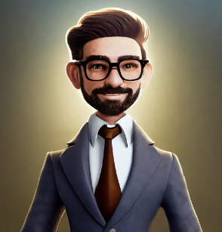

Choose Your Coach
George
Amanda
Notes:
Allow the learner to select the character.
Screen No.: 2
Screen Type: Animation
Narration: Choose your coach from the given list.
Art Direction Notes: NA

Slide 35
Meet the coach
Hi, I am George. I will guide you through this self-transformational journey.
Select Launch to begin
Launch
<
>
Notes:
<upon choosing George>
Screen No.: 2
Screen Type: Animation
Narration: Hi, I am George. I will guide you through this self-transformational journey. Select Launch to begin when you’re ready. (Male VO)
Art Direction Notes: NA

Slide 36
Meet the coach
Hi, I am Amanda. I will guide you through this self-transformational journey.
Select Launch to begin
Launch
<
>
Notes:
<upon choosing Amanda>
Screen No.: 2
Screen Type: Animation
Narration: Hi, I am Amanda. I will guide you through this self-transformational journey. Select Launch to begin when you’re ready. (Female VO)
Art Direction Notes: NA

Slide 37

Roadmap of the Journey
The series aims to lead the foundation of the self-transformation journey by reprogramming your subconscious mind.
<
>
Notes:
Screen No.: 3
Screen Type: Text with Image
Narration:
The series aims to lead the foundation of the self-transformation journey by reprogramming your subconscious mind.
Art Direction Notes: Start button and navigate to the next screen.
Edit the infographic to show the roadmap of the journey. The journey will have four major checkpoints: self-awareness, affirmations, meditations, and emotional freedom technique(EFT).
Make all location pointers clickable.

Slide 38

Meet Sarah
A Young professional with the dream of starting her own business.
But, She is struggling with:
Self-Doubt
Lack of Confidence
Fear of Failure
Negative Thought Pattern
<
>
Notes:
Screen No.: 4
Screen Type: Text with Image
Narration:
Meet Sarah, a determined young professional with dreams of launching her own business. But she's wrestling with self-doubt, lack of confidence, the fear of failure, and negative thought patterns. Through the journey of Sarah, you will watch her transform and learn various subconscious programming and techniques.
Art Direction Notes:
Synch the OST with VO.

Slide 39


I've always dreamed of starting my own business, but...I can't help feeling this overwhelming self-doubt and this constant fear of failing. It's like there's this negative cloud of thoughts that just won't go away. I know I need to make a change. I want to make a change.
Select to listen to audio.
<
>
Notes:
Screen No.: 5
Screen Type: Animation
Narration: I've always dreamed of starting my own business, but...I can't help feeling this overwhelming self-doubt and this constant fear of failing. It's like there's this negative cloud of thoughts that just won't go away. I know I need to make a change. I want to make a change.
Art Direction Notes: Make the narration appear on screen with voice-over in the thought bubble. Voice-over should be different voice than that of the coaches used earlier.

Slide 40
Self-Awareness
Okay, I heard. Are you aware of your thought patterns?
No. I don’t know. It just suddenly comes and can’t stop these thoughts.
<
>
Notes:
Screen No.: 7
Screen Type: Animation
Narration: Okay, I heard. Are you aware of your thought patterns?
No. I don’t know. It just suddenly comes and can’t stop these thoughts.
Art Direction Notes: For the coach, the image chosen by the learner will be represented—and the voiceover.

Slide 41
Self-Awareness
Okay, got you. Do you observe when this happens to you? Is there any trigger?
No, actually I never realized this.
<
>
Notes:
Continued screen
Screen No.: 7
Screen Type: Animation
Narration: Okay, got you. Do you observe when this happens to you? Is there any trigger?
No, actually I never realized this.
Art Direction Notes: For the coach, the image chosen by the learner will be represented—and the voiceover.

Slide 42
Self-Awareness
Okay, not a problem. Here is the first task for you. Start writing the journal, and make notes of your thought patterns, when it comes, and what the trigger is. And bring your journal to me in the next session.
Okay, sure, I will start writing about it.
<
>
Notes:
Continued screen
Screen No.: 7
Screen Type: Animation
Narration: Okay, not a problem. Here is the first task for you. Start writing the journal, and make notes of your thought patterns, when it comes, and what the trigger is. And bring your journal to me in the next session.
Okay, sure, I will start writing about it.
Art Direction Notes: For the coach, the image chosen by the learner will be represented—and the voiceover.

Slide 43



Self-Awareness
Select the icon to know more
Be
Aware
Recognize thoughts
Start Journaling
<
>
Notes:
Screen No.: 8
Screen Type: Animation
Narration: NA
Art Direction Notes: Show the icons, the icons should be clickable, and expands as given on next slides. Disable the next button. And enable it when learner visit all tabs.

Slide 44

Self-Awareness
Select the icon to know more
Be
Aware
Recognize thoughts
Start Journaling
Becoming aware of the negative or limiting beliefs.
<
>
Notes:
Continued screen
Screen No.: 8
Screen Type: Animation
Narration: Becoming aware of the negative or limiting beliefs.
Art Direction Notes: Show the icons, the icons should be clickable, and expands as given on next slides.

Slide 45

Self-Awareness
Select the icon to know more
Be
Aware
Recognize thoughts
Start Journaling
By self-reflection and introspection, you can recognize the negative thoughts you want to change.
<
>
Notes:
Continued screen
Screen No.: 8
Screen Type: Animation
Narration: By self-reflection and introspection, you can recognize the negative thoughts you want to change.
Art Direction Notes: Show the icons, the icons should be clickable, and expands as given on next slides.

Slide 46

Self-Awareness
Select the icon to know more
Be
Aware
Recognize thoughts
Start Journaling
Start journaling to help identify these beliefs and thought patterns.
<
>
Notes:
Continued screen
Screen No.: 8
Screen Type: Animation
Narration: Start journaling to help identify these beliefs and thought patterns.
Click next icon to continue.
Art Direction Notes: Show the icons, the icons should be clickable, and expands as given on next slides.

Slide 47
KNOWLEDGE
CHECK
Notes:
Screen Type: Transition Screen
Narration: So that’s a lot to keep track of. Let’s see how much you remember.
Art Direction Notes: Screen will transition to the next topic after the audio.

Slide 48
Q
Q1: Sarah has recently started her journey of self-awareness, determined to overcome her self-doubt and fear of failure. She begins to keep a journal where she reflects on her negative thought patterns. One day, she realizes that a recurring belief is, "I'm not good enough to start my own business." What should Sarah do next to continue her self-awareness journey effectively?
Select the suitable option and Submit when you are finished.
Write that belief in her journal and ignore it, hoping it will go away on its own.
Confront the belief by reflecting on its origins and how it affects her.
Share the belief with friends and family to get their opinions.
Immediately create positive affirmations without analyzing the belief.
Submit
Notes:
Screen No.: 8
Screen Type: KC 1 – MCQ
Narration: Sarah has recently started her journey of self-awareness, determined to overcome her self-doubt and fear of failure. She begins to keep a journal where she reflects on her negative thought patterns. One day, she realizes that a recurring belief is, "I'm not good enough to start my own business." What should Sarah do next to continue her self-awareness journey effectively?
Select the suitable option and Submit when you are finished.
Art Direction Notes:
Correct answer: Confront the belief by reflecting on its origins and how it affects her.
Correct Feedback: That’s right! Sarah should confront her belief by reflecting on its originate and how it affects her.
Incorrect Feedback: Not quite. Try again.

Slide 49
Q
Q1: Sarah has recently started her journey of self-awareness, determined to overcome her self-doubt and fear of failure. She begins to keep a journal where she reflects on her negative thought patterns. One day, she realizes that a recurring belief is, "I'm not good enough to start my own business." What should Sarah do next to continue her self-awareness journey effectively?
Select the suitable option and Submit when you are finished.
Write that belief in her journal and ignore it, hoping it will go away on its own.
Confront the belief by reflecting on its origins and how it affects her.
That’s right! Sarah should confront her belief by reflecting on its originate and how it affects her.
Share the belief with friends and family to get their opinions.
Immediately create positive affirmations without analyzing the belief.
Submit
Notes:
Screen No.: 8
Screen Type: KC 1 – MCQ
Narration: Sarah has recently started her journey of self-awareness, determined to overcome her self-doubt and fear of failure. She begins to keep a journal where she reflects on her negative thought patterns. One day, she realizes that a recurring belief is, "I'm not good enough to start my own business." What should Sarah do next to continue her self-awareness journey effectively?
Select the suitable option and Submit when you are finished.
Art Direction Notes:
Correct answer: Confront the belief by reflecting on its origins and how it affects her.
Correct Feedback: That’s right! Sarah should confront her belief by reflecting on its originate and how it affects her.
Incorrect Feedback: Not quite. Try again.

Slide 50
Q
Q1: Sarah has recently started her journey of self-awareness, determined to overcome her self-doubt and fear of failure. She begins to keep a journal where she reflects on her negative thought patterns. One day, she realizes that a recurring belief is, "I'm not good enough to start my own business." What should Sarah do next to continue her self-awareness journey effectively?
Select the suitable option and Submit when you are finished.
Write that belief in her journal and ignore it, hoping it will go away on its own.
Confront the belief by reflecting on its origins and how it affects her.
Not quite. Try Again!
Share the belief with friends and family to get their opinions.
Immediately create positive affirmations without analyzing the belief.
Try Again
Submit
Notes:
Screen No.: 8
Screen Type: KC 1 – MCQ
Narration: Sarah has recently started her journey of self-awareness, determined to overcome her self-doubt and fear of failure. She begins to keep a journal where she reflects on her negative thought patterns. One day, she realizes that a recurring belief is, "I'm not good enough to start my own business." What should Sarah do next to continue her self-awareness journey effectively?
Select the suitable option and Submit when you are finished.
Art Direction Notes:
Correct answer: Confront the belief by reflecting on its origins and how it affects her.
Correct Feedback: That’s right! Sarah should confront her belief by reflecting on its originate and how it affects her.
Incorrect Feedback: Not quite. Try again.

Slide 51
As I've been writing in my journal, I've begun to trace the origins of these thoughts that keep holding me back. It's like I can see where they came from, the moments in my past that planted these seeds of self-doubt. But, even though I'm becoming more self-aware, I can't help but wonder if I'll ever truly believe in myself enough to achieve my dream of starting a business.
Select to listen to audio.
Notes:
Screen No.: 9
Screen Type: Animation
Narration: As I've been writing in my journal, I've begun to trace the origins of these thoughts that keep holding me back. It's like I can see where they came from, the moments in my past that planted these seeds of self-doubt. But, even though I'm becoming more self-aware, I can't help but wonder if I'll ever truly believe in myself enough to achieve my dream of starting a business.
Art Direction Notes: Make the narration appear on screen with voice-over in the thought bubble.

Slide 52
Positive Affirmations
Okay, I got your point. Show me your journal.
Yes, here it is.
<
>
Notes:
Screen No.: 10
Screen Type: Animation
Narration: Okay, I got your point. Show me your journal.
Yes, here it is.
.
Art Direction Notes: For the coach, the image chosen by the learner will be represented—and the voiceover.

Slide 53
Positive Affirmations
That’s great! I can see you have written all the things causing these thoughts.
Yes, I tried to identify the pattern. Still, I am not sure if I can start my dream business.
<
>
Notes:
Continued screen
Screen No.: 10
Screen Type: Animation
Narration: That’s great! I can see you have written all the things causing these thoughts.
Yes, I tried to identify the pattern. Still, I am not sure if I can start my dream business.
Art Direction Notes: For the coach, the image chosen by the learner will be represented—and the voiceover.

Slide 54
Positive Affirmations
Okay, not a problem. First, set the clear goal that you want to achieve. Then use positive affirmations like, “I am confident and capable.” And try to repeat these often.
Okay. Can you help me write the same?
<
>
Notes:
Continued screen
Screen No.: 10
Screen Type: Animation
Narration: Okay, not a problem. First, set the clear goal that you want to achieve. Then use positive affirmations like, “I am confident and capable.” And try to repeat these often.
Okay. Can you help me write the same?
Art Direction Notes: For the coach, the image chosen by the learner will be represented—and the voiceover.

Slide 55



Positive Affirmations
Select the icon to know more
Counteract Negativity
Positive Statements
Present Tense
Notes:
Screen No.: 11
Screen Type: Animation
Narration: NA
Art Direction Notes: Show the icons, the icons should be clickable, and expands as given on next slides.

Slide 56

Positive Affirmations
Select the icon to know more
Counteract Negativity
Positive Statements
Present Tense
Create positive affirmation in a way that it counteracts the negative and limiting belief.
Notes:
Continued screen
Screen No.: 11
Screen Type: Animation
Narration: Create positive affirmation in a way that it counteracts the negative and limiting belief.
Art Direction Notes: Show the icons, the icons should be clickable, and expands as given on next slides.

Slide 57

Positive Affirmations
Select the icon to know more
Counteract Negativity
Positive Statements
Present Tense
Affirmations are positive statements that you repeat to yourself regularly.
Notes:
Continued screen
Screen No.: 11
Screen Type: Animation
Narration: Affirmations are positive statements that you repeat to yourself regularly.
Art Direction Notes: Show the icons, the icons should be clickable, and expands as given on next slides.

Slide 58

Positive Affirmations
Select the icon to know more
Counteract Negativity
Positive Statements
Present Tense
They should be in the present tense and reflect the desired state of your subconscious mind.
For example, "I am confident and capable."
Notes:
Continued screen
Screen No.: 11
Screen Type: Animation
Narration: They should be in the present tense and reflect the desired state of your subconscious mind.
For example, "I am confident and capable."
Art Direction Notes: Show the icons, the icons should be clickable, and expands as given on next slides.

Slide 59
PLAY
TIME
Notes:
Screen Type: Transition Screen
Narration: So that’s a lot to keep track of. Let’s see if you can help Sarah by recognizing the positive affirmations.
Art Direction Notes: Screen will transition to the next topic after the audio.

Slide 60


Q
Some affirmation examples will be shown on screen. Identify the correct affirmation by clicking the “YES” and “NO” buttons provided below.
I will become confident and capable someday.
Notes:
Screen No.: 12
Screen Type: KC 1 –Gamified scoring quiz
Narration: Some affirmation examples will be shown on screen. Identify the correct affirmation by clicking the “YES” and “NO” buttons provided below.
Art Direction Notes: Make the affirmations appear one by one on screen. Set the timer for 60 seconds. Create a scored quiz.
This statement belongs to NO category.

Slide 61
Q
Some affirmation examples will be shown on screen. Identify the correct affirmation by clicking the “YES” and “NO” buttons provided below.
I am confident and capable.
Notes:
Continued screen.
Screen No.: 12
Screen Type: KC 1 –Gamified scoring quiz
Narration: Some affirmation examples will be shown on screen. Identify the correct affirmation by clicking the “YES” and “NO” buttons provided below.
Art Direction Notes: Make the affirmations appear one by one on screen. Set the timer for 60 seconds. Create a scored quiz.
This statement belongs to YES category.

Slide 62
Q
Some affirmation examples will be shown on screen. Identify the correct affirmation by clicking the “YES” and “NO” buttons provided below.
I used to doubt myself, but I’ll be better.
Notes:
Continued screen.
Screen No.: 12
Screen Type: KC 1 –Gamified scoring quiz
Narration: Some affirmation examples will be shown on screen. Identify the correct affirmation by clicking the “YES” and “NO” buttons provided below.
Art Direction Notes: Make the affirmations appear one by one on screen. Set the timer for 60 seconds. Create a scored quiz.
This statement belongs to NO category.

Slide 63
Q
Some affirmation examples will be shown on screen. Identify the correct affirmation by clicking the “YES” and “NO” buttons provided below.
I attract success and abundance into my life.
Notes:
Continued screen.
Screen No.: 12
Screen Type: KC 1 –Gamified scoring quiz
Narration: Some affirmation examples will be shown on screen. Identify the correct affirmation by clicking the “YES” and “NO” buttons provided below.
Art Direction Notes: Make the affirmations appear one by one on screen. Set the timer for 60 seconds. Create a scored quiz.
This statement belongs to YES category.

Slide 64
Q
Some affirmation examples will be shown on screen. Identify the correct affirmation by clicking the “YES” and “NO” buttons provided below.
I might succeed if I am lucky.
Notes:
Continued screen.
Screen No.: 12
Screen Type: KC 1 –Gamified scoring quiz
Narration: Some affirmation examples will be shown on screen. Identify the correct affirmation by clicking the “YES” and “NO” buttons provided below.
Art Direction Notes: Make the affirmations appear one by one on screen. Set the timer for 60 seconds. Create a scored quiz.
This statement belongs to NO category.
Once the timer is over, Show the results on screen.

Slide 65

Q
Some affirmation examples will be shown on screen. Identify the correct affirmation by clicking the “YES” and “NO” buttons provided below.
Congratulations!
You scored 10 points.
Notes:
Continued screen.
Screen No.: 12
Screen Type: KC 1 –Gamified scoring quiz
Narration: Some affirmation examples will be shown on screen. Identify the correct affirmation by clicking the “YES” and “NO” buttons provided below.
Art Direction Notes: Make the affirmations appear one by one on screen. Set the timer for 60 seconds. Create a scored quiz.
Once the timer is over, Show the results on screen.

Slide 66
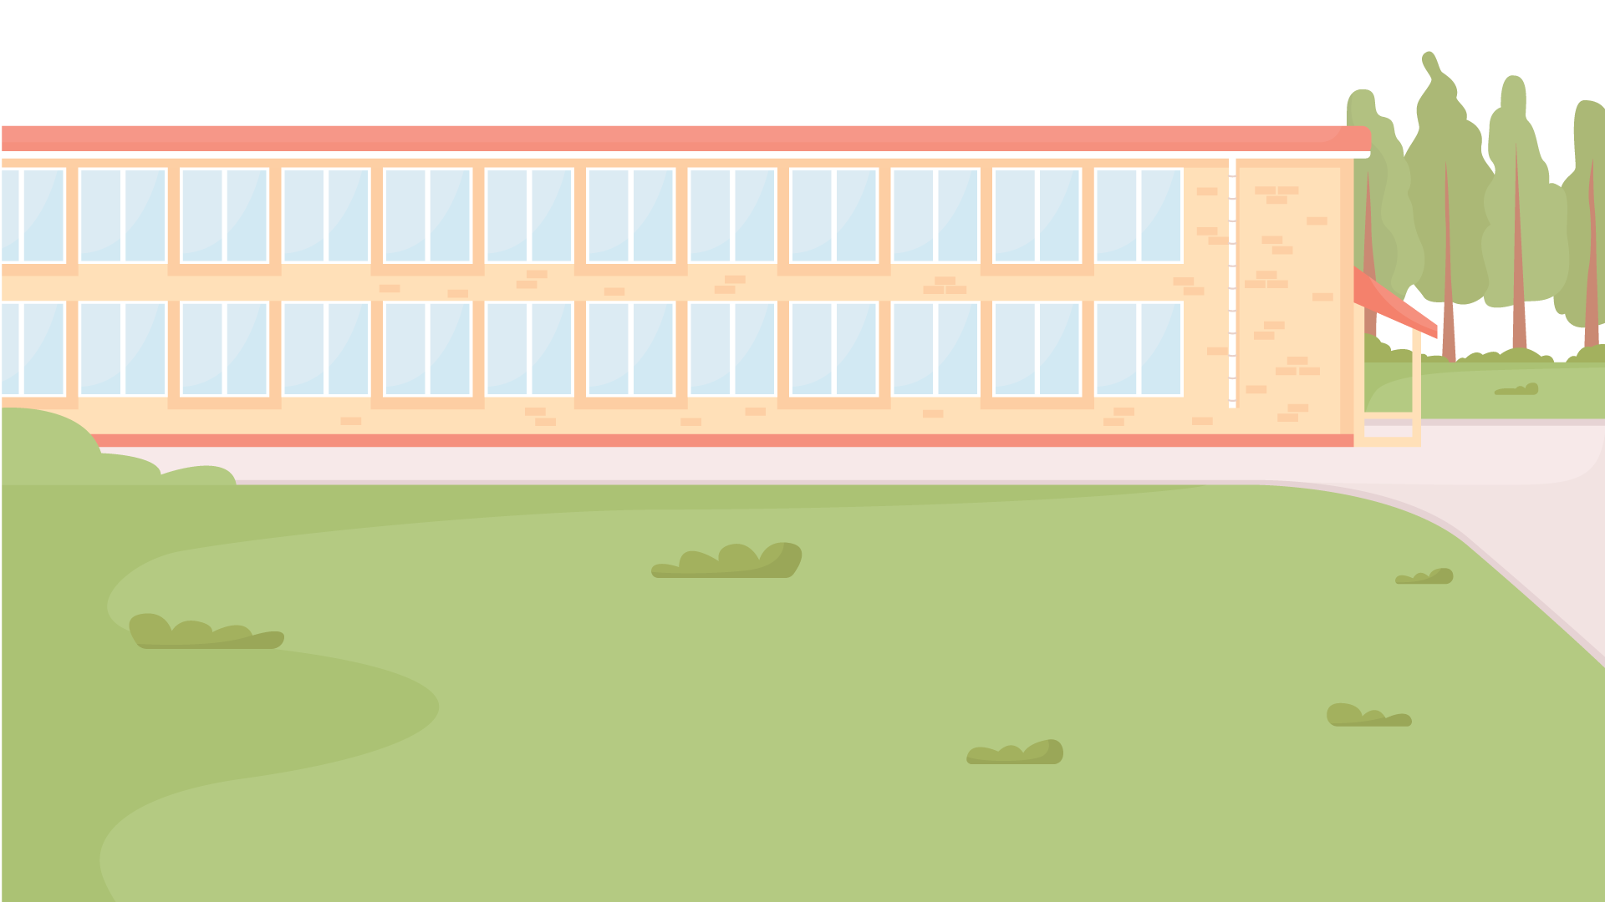
Great!
You’ve completed the module.

